Slide 1

CGB1201 – JAVA PROGRAMMING
Department of Artificial Intelligence and Data Science Academic Year: 2024 – 2025 (Odd Semester)
Register Number
Name Year Semester Section Date
: 2303811724321094
: SAI NITHICK ROSHAAN S
: II Year
: III
: B
: 25-11-2024
1
CGB1201 – JAVA PROGRAMMING

Slide 2

FOOD ORERING SYSTEM
2
CGB1201 – JAVA PROGRAMMING

Slide 3

Problem Identification
Error-Prone Manual Processes: Traditional order-taking methods often lead to mistakes in calculations and tracking.
Complex Interfaces: Many systems lack simplicity, making it difficult for users to place orders efficiently.
Limited Customization: Customizing orders is tedious without a clear and user-friendly mechanism.
2
CGB1201 – JAVA PROGRAMMING

Slide 4

Objective
Streamline Food Ordering:
Develop a simple and intuitive system that makes the food ordering process quick and hassle-free for users.
Ensure Accuracy:
Automate calculations to eliminate manual errors and provide reliable order summaries.
Enhance Customization:
Offer flexibility for users to easily customize their orders
according to their preferences.
2
CGB1201 – JAVA PROGRAMMING

Slide 5

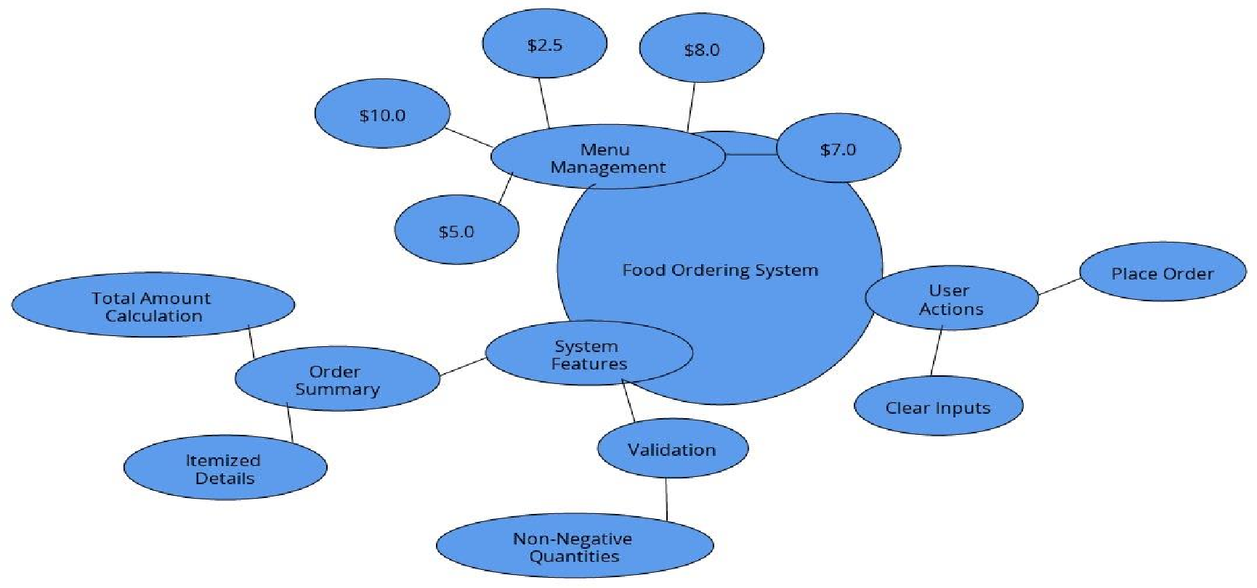
Proposed Architecture
2
CGB1201 – JAVA PROGRAMMING

Slide 6

Java Programming - Concepts Used
AWT: Utilized to develop the graphical user interface with essential components.
ActionListener: Implemented for effective event handling and user interaction.
try-catch: Applied to manage exceptions and ensure
program stability.
GridLayout and FlowLayout: Used to organize and
structure GUI components.
2
CGB1201 – JAVA PROGRAMMING

Slide 7

List of Modules
User Interface Module:
Input Handling
Display Components
Layout Management
Order Management Module:
Input Parsing and Validation
Calculation Engine
Order Summary Generator

Slide 8

List of Modules
Notification and Error Handling Module:
Error Detection
Order Confirmation
User Alerts

Slide 9

Module Description
User Interface Module:
Input Handling: Manages user input for item quantities and displays relevant labels.
Display Components: Includes text fields, buttons, and labels to present the order form and summary.
Layout Management: Uses GridLayout and FlowLayout to arrange the components in an organized manner.

Slide 10

Module Description (Cont..)
Order Management Module:
Input Parsing and Validation: Parses user input using Integer.parseInt and checks for valid, non- negative values.
Calculation Engine: Computes the total cost based on the selected quantities of menu items.
Order Summary Generator: Constructs and formats the order summary for display.

Slide 11

Module Description (Cont..)
Notification and Error Handling Module:
Error Detection: Catches input errors using try- catch blocks and displays appropriate messages.
Order Confirmation: Provides a summary and confirmation once an order is successfully placed.
User Alerts: Displays pop-ups or new windows to inform users of errors or successful operations.

Slide 12

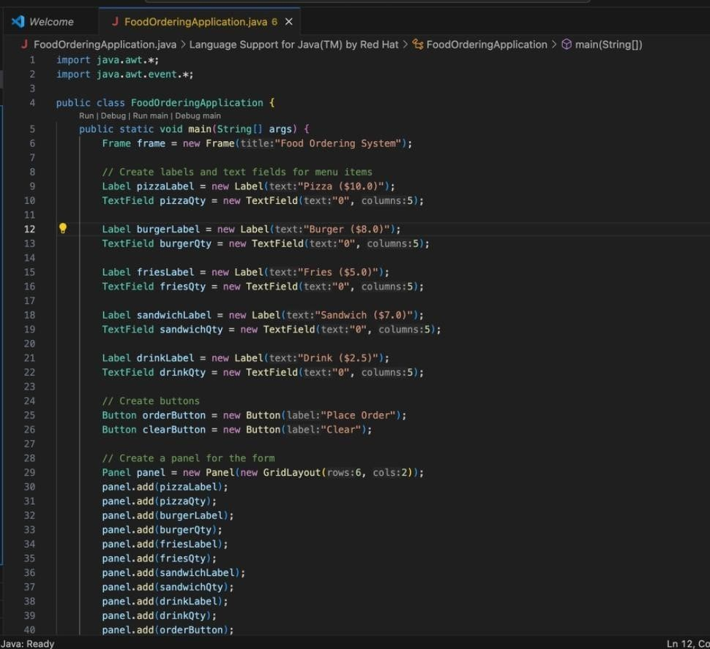
Source Code

Slide 13

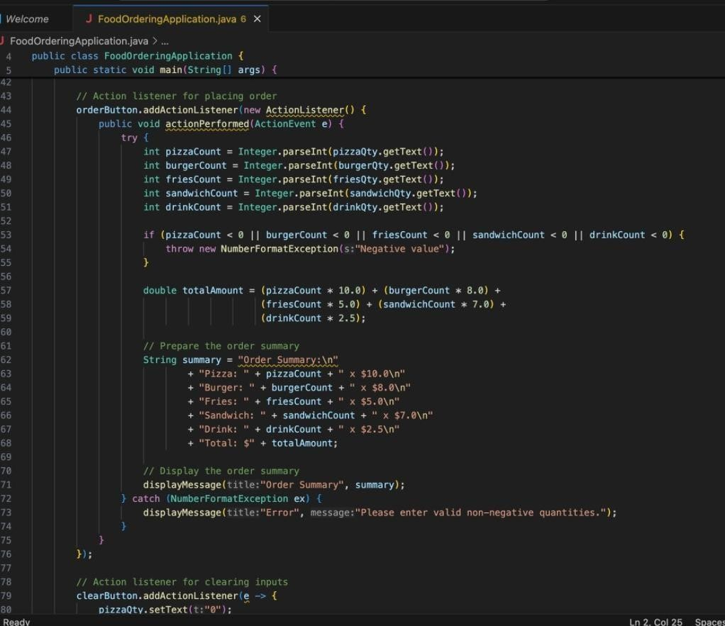
Source Code
🞂

Slide 14

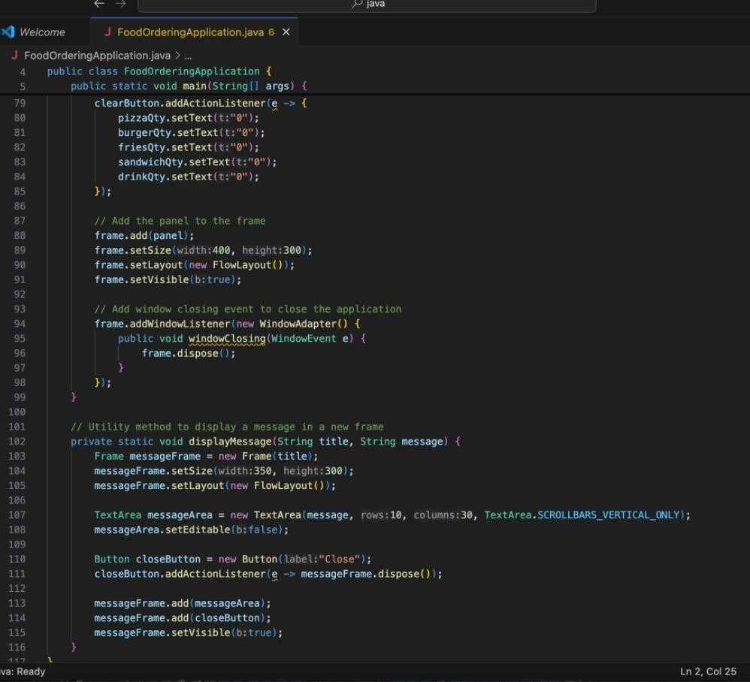
Source Code

Slide 15

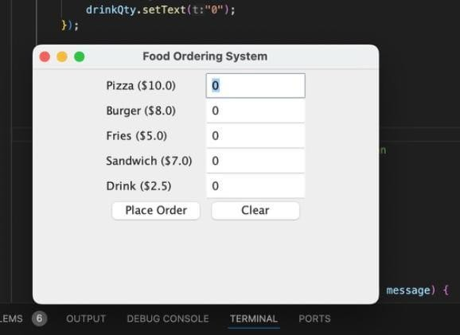
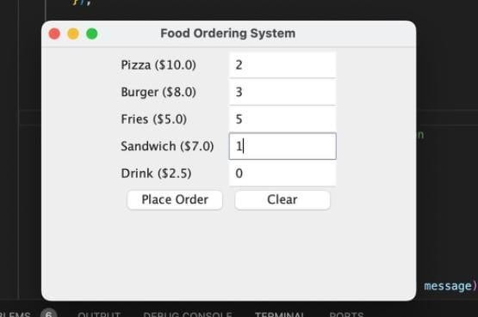
Results
n

Slide 16

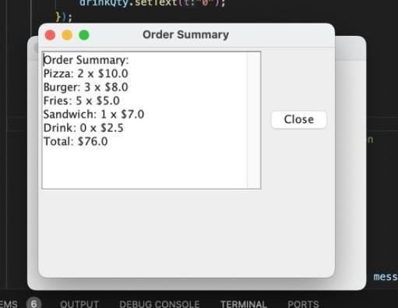
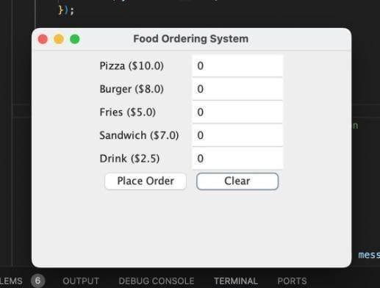
Results

Slide 17

Conclusion
The Food Ordering System project successfully demonstrates the integration of core programming concepts to create an efficient and user-friendly application. The modular architecture ensures easy maintenance and scalability, while the clear user interface and robust order management enhance the user experience. By implementing effective error handling and notifications, the system provides a reliable and interactive platform for placing food orders.

Slide 18

Thank You
ANY QUERIES???

